Slide 1
Presentation on: Experiment 2
Experiment Name
Diode Circuit Analysis and Logic gates using diodes
Presented by: Md. Abdul Mutalib
ID: 190303020001
Semester: 8th
Dept. of CSE
North East University Bangladesh

Slide 2
Outline of this presentation
Objective
Theory
Apparatus Needed
Circuits
Procedure
Report

Slide 3
Objective:
The objective of this experiment is to analyse simple diode circuits and to build logic circuits using diodes and resistors.

Slide 4
Theory:
To complete this lab need to read:-
Lecture-1
Lecture-2
Lecture-3

Slide 5
Apparatus Needed
Trainer Board (Bread Board)
Diodes
Resistor
DC Voltmeter
DC Ammeter
DC Power supply
Function Generator
Oscilloscope
Connecting Wires

Slide 6
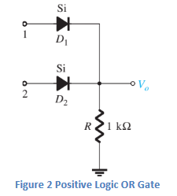
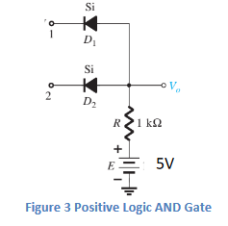
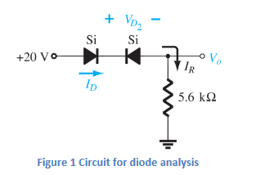
Circuit
Here, I have attached 3 Figures of the circuit.

Slide 7
Report:
1. Carefully Fill all the data for table 1, 2, 3. 2. Comment on the learnings from this LAB.

Slide 8
END

